Slide 1



Labano Academy Finial Project
On
Profitability Analysis in Atmes Bike Sales
BY
COHORT-4
RICHARD AKINWARE

Slide 2
Introduction:
Atmes Bikes Company is a leading provider in the bicycle industry, offering a diverse range of bicycles and accessories to customers worldwide.
This is a Microsoft excel project to gain insights into The dataset provided, offering a comprehensive view of customer transactions, including Date, Day, Month, Year, Customer Age, Age Group, Customer Gender, Country, State, Product Category, Sub-category, Product, Order Quantity, Unit Cost, Unit Price, Profit, Cost, and Revenue.

Slide 3
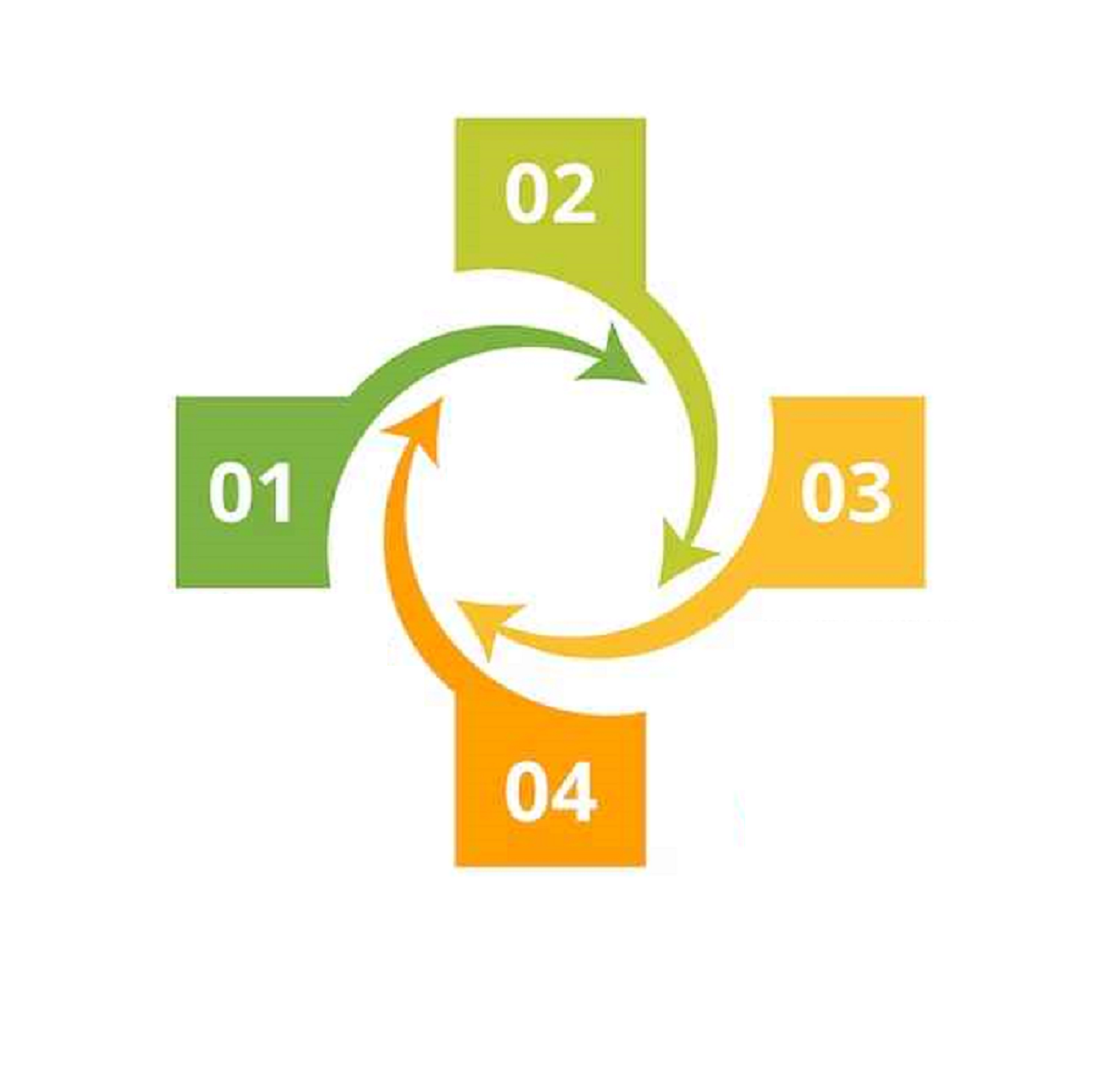
PROCESS WORKFLOW
Cleaning and Transformation of data
Collecting and preparing dataset
Recommendation and Conclusion
Analysis And visualization

Slide 4
PROBLEM STATEMENT
Atmes bike store faces the challenge of optimizing inventory turnover and profitability while effectively catering to the diverse needs and preferences of its customer base.

Slide 5

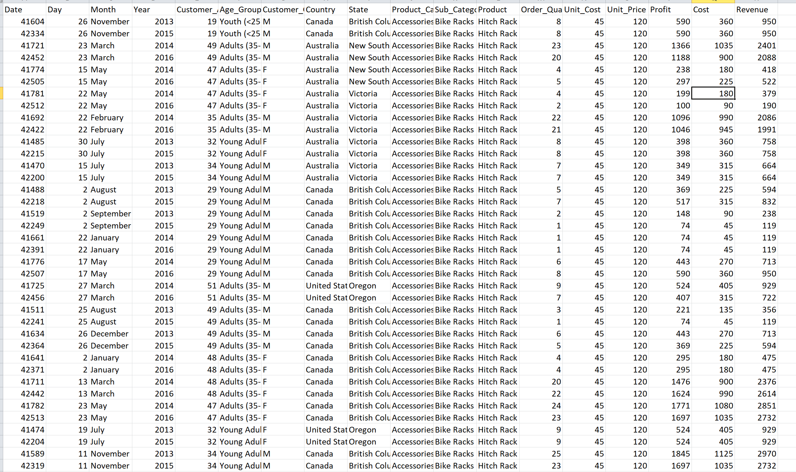
UNCLEAN DATA

Slide 6
DATA CLEANING PROCESS
Identifying and Handling Missing Values
Removing Duplicates Entries
Standardizing Data Formats
Correcting Data inconsistences on the text

Slide 7
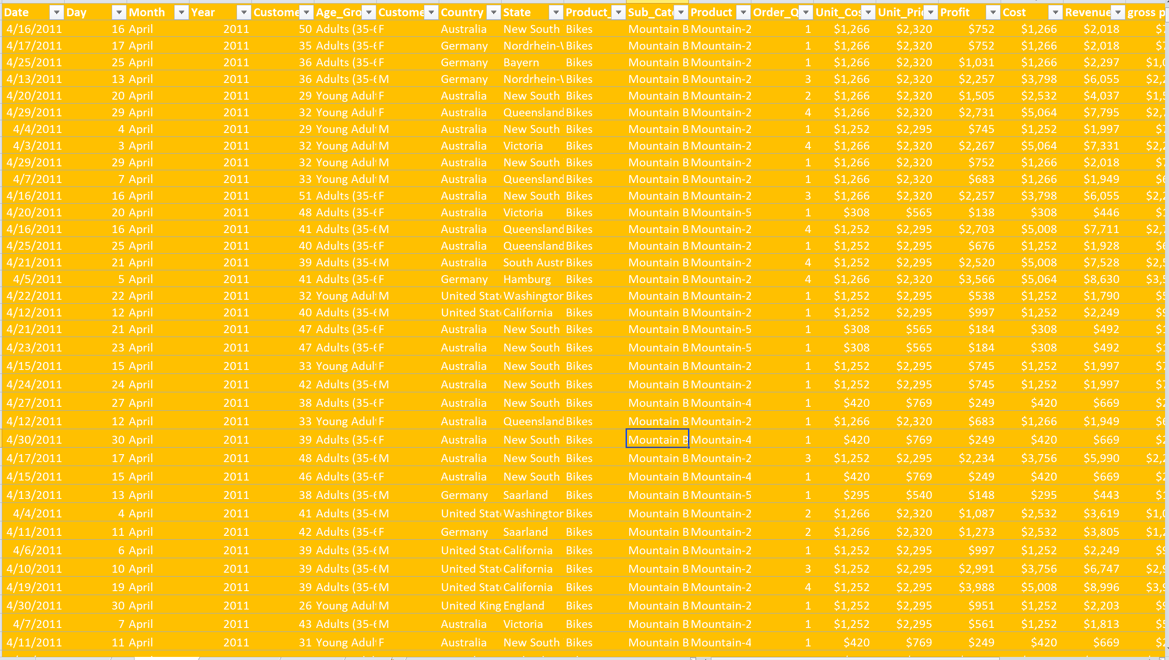
CLEAN DATA

Slide 8
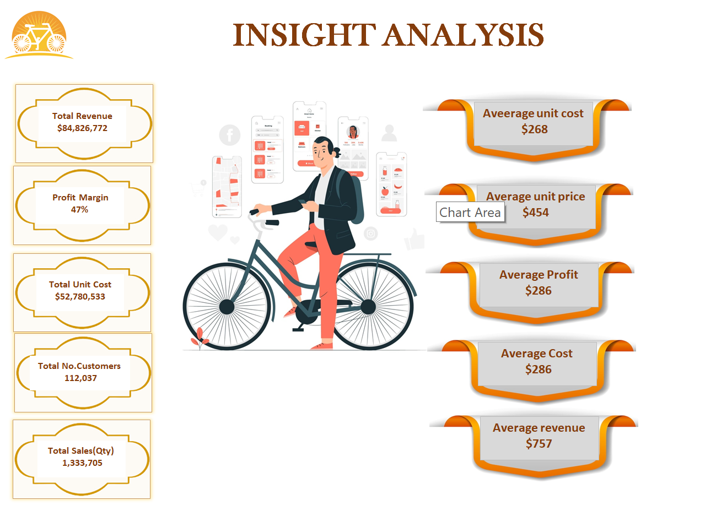

Slide 9
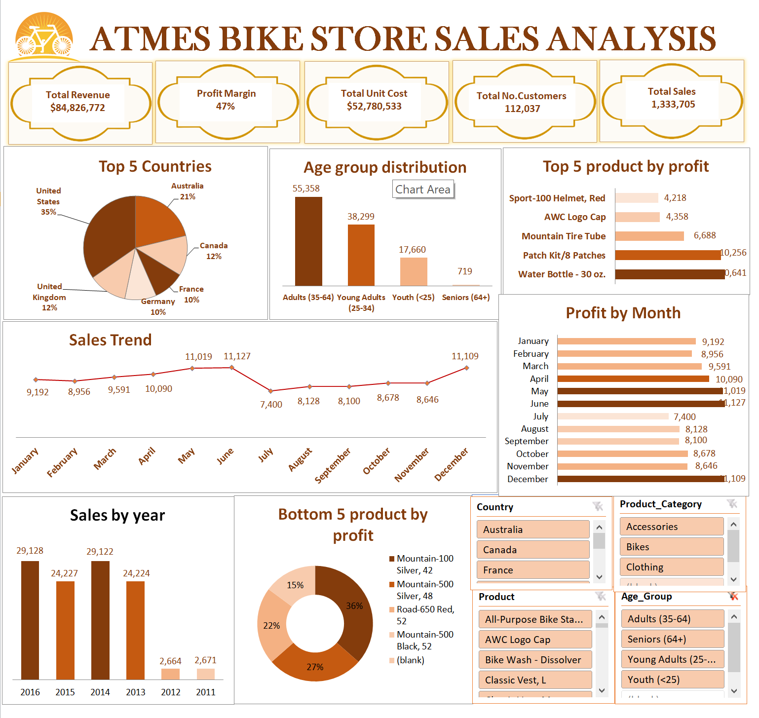

Slide 10
RECOMMENDATION
There is need to Develop targeted marketing campaigns to focused on reaching potential customers during key moments in May, June, and December and Utilize various channels such as social media, email marketing, and digital advertising to promote seasonal offers and drive traffic to the store.
Consider stocking popular bike models, accessories, and gear that are favored by customers in in the United States, United Kingdom, Austria, Canada, and Germany. each market,
water bottles and patch kits as essential gear for cyclists during peak seasons such as spring and summer. Offer seasonal discounts, Capitalize on seasonal trends.

Slide 11
LIMITATION
We had limitation is the occurrence of low sales months for bikes and accessories. During these periods, revenue generation may be constrained, impacting overall profitability and growth potential.
One limitation is the occurrence of very low sales in the years 2011 and 2012. These periods of reduced sales may pose challenges to revenue generation and profitability, impacting overall business performance.

Slide 12
CONCLUSION
It is imperative to develop targeted marketing campaigns aimed at reaching potential customers during key moments, Utilizing various channels advertisement can effectively promote seasonal offers and drive traffic to the store.
careful analysis of the factors contributing to the low sales during these specific years and implementing strategic measures to mitigate their impact.

Slide 13


